Slide 1
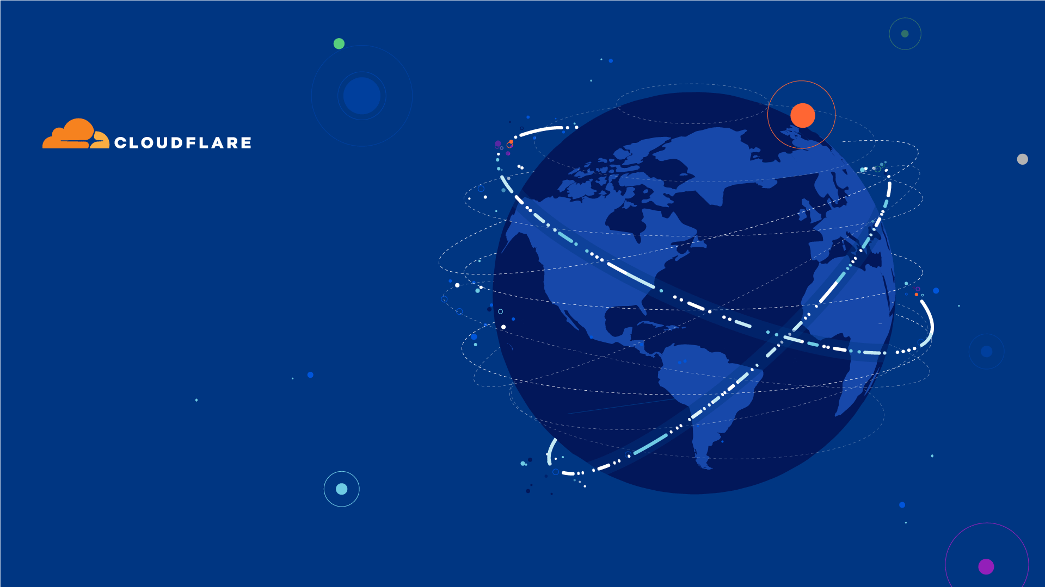
The network for digital transformation
MARCH 2022

Slide 2
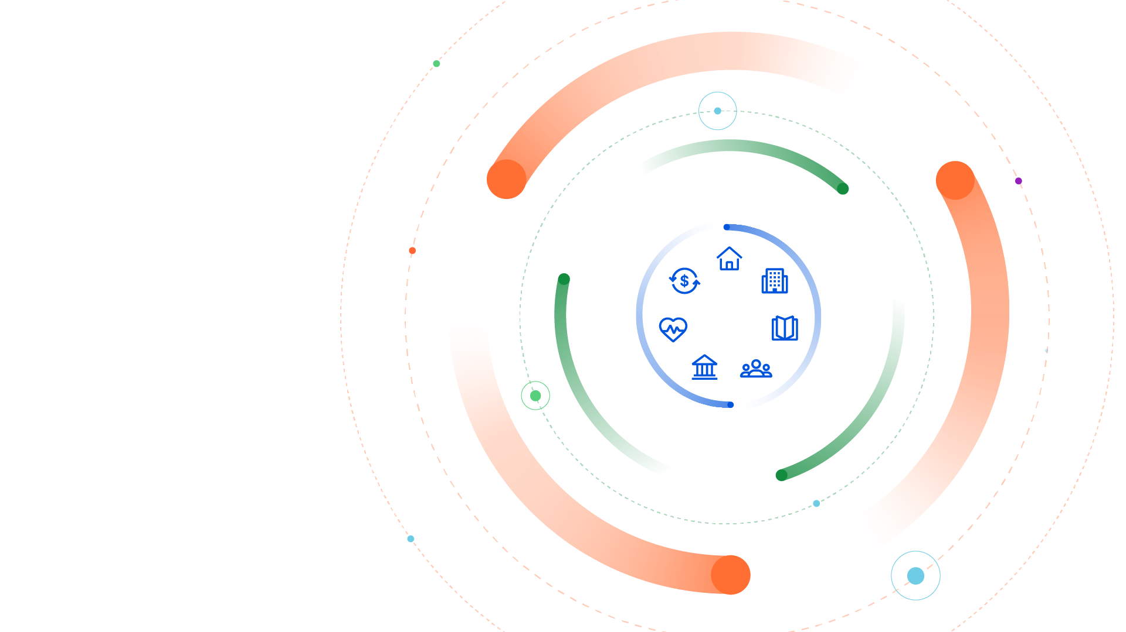



What’s happening
In the world today?
Everything is digitizing
Enabled by specialized
cloud platforms
All of it riding on top of the Internet, yet…
Notes:
Our entire lives are digitizing. Shopping, Finance, Healthcare, School, Work, Voting, Taxes, Entertainment, you name it.
Accelerated of course by the last two years living in the pandemic
All of this digitization is being enabled by specialized cloud platforms, whether it’s Zoom, Salesforce, Stripe, or Nvidia, iOS, Shopify, Twilio, Netflix, Blackboard, ADP, Spotify, and many others, and of course there’s the large public cloud providers
And all of this is riding on the Internet…kind of amazing that it works MOST of the time.
But we know the Internet is still not perfect…

Slide 3
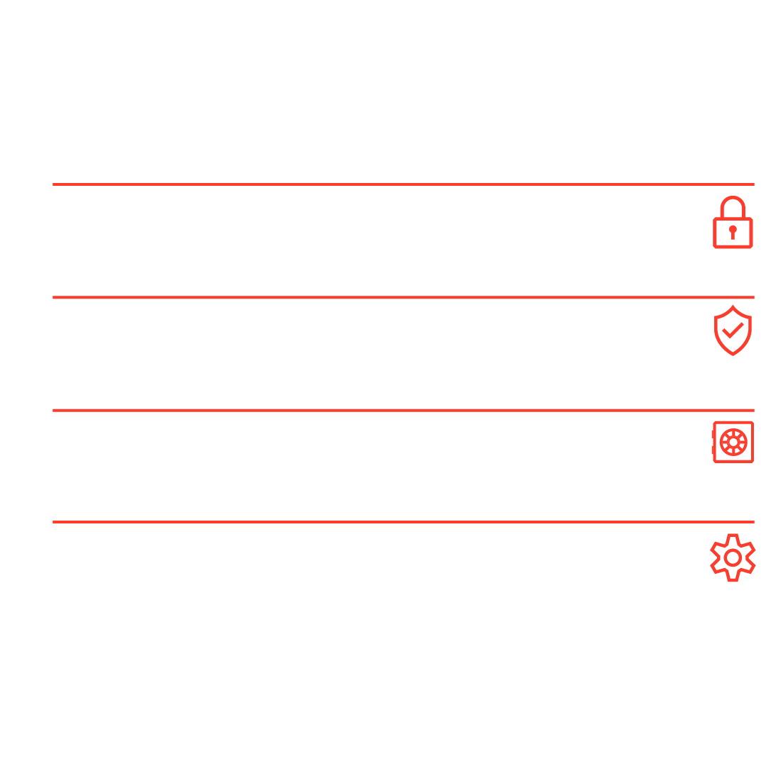
The Internet isn’t:
Secure enough
Reliable enough
Private enough
Automated enough
Notes:
And as we’ve seen in 2021 with very prominent and very public outages and breaches, the reality of the internet is that it is far from the network that we need it to.
The reality is that the Internet is still not secure enough. Whether its Denial of Service, Ransomware, Account Takeover, or web scraping, we are still seeing too many breaches.
The reality is that the Internet is still not as reliable as a utility. Whatever the cause, we have witnessed some prominent outages in 2021 that affected BILLIONS of people worldwide.
The reality is that the data and insights of our entire lives is on the Internet, and we are only now starting to understand and implement privacy measures and controls.
Finally, unless you are part of the heroes that run the Internet, you may not know how manual the operations often are. We have to get better at automating the running and maintenance of the Internet.

Slide 4
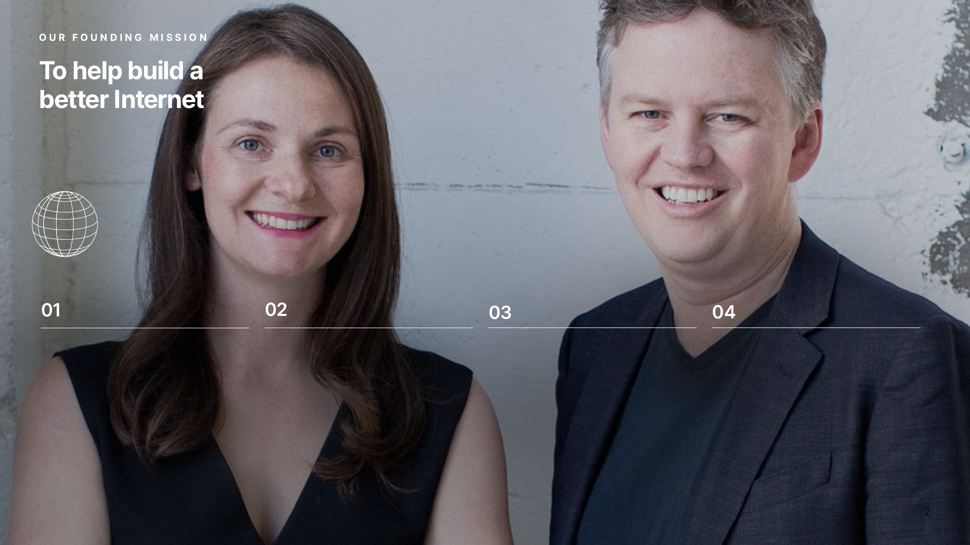
Improve the quality
of the Internet for
everyone, not just
those with big teams
Reduce complexity
and friction
Implement the latest
protocols & standards
Make the network
programmable
Notes:
When we started the company over 10 years ago, this was exactly our mission: how can we build a better Internet?
And for everyone - from the individual to the startup to the most established companies in the world.
We realized that if can reduce the complexity of the Internet, always implement the latest protocols and standards, and most importantly, make the network programmable, then we would be able to have a positive impact on the Internet.
In essence, Cloudflare was created and exists to make the Internet better…for everyone.

Slide 5
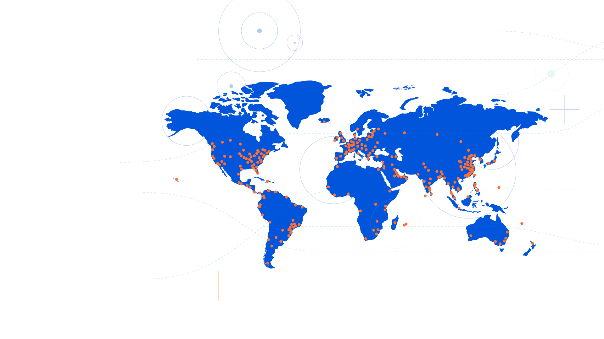
The Cloudflare
global network
250+
cities in 100+ countries,
including mainland China
10,000
networks directly connect
to Cloudflare, including ISPs, cloud providers & large enterprises
121 Tbps
of network edge capacity
& growing
= Cloudflare city (Map data as of September 15, 2021)
Notes:
It all starts with our global network. We’ve been building it for over 10 years. We’ve spent hundreds of millions on the footprint to get us within 50 milliseconds of 95% of the users on the Internet. And we continue to make this one of our top priorities.
Our infrastructure is in data centers in over 250 cities around the world across 100 countries.
We connect directly to over 10,000 major networks including ISPs, Carriers, cloud providers, and even large enterprises. We operate our own backbone and most carriers are delighted to partner with us because we serve a significant portion of the Internet, which translates to a lot of traffic.
At the end of 2021, our overall capacity was 121 Tbps, and that’s growing everyday. We are servicing 4M+ customers with 35M websites/apps.

Slide 6
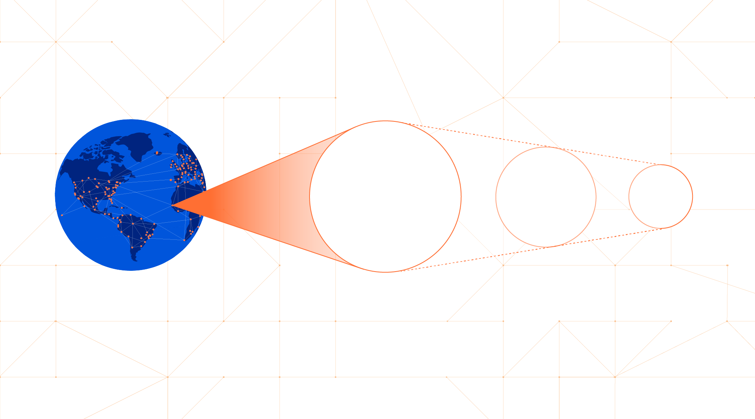
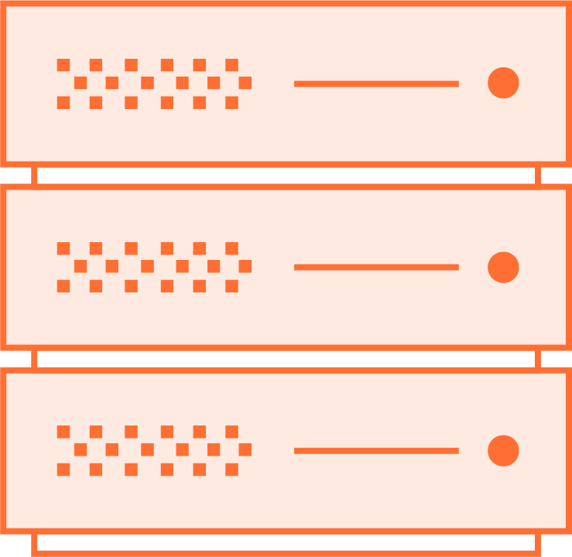

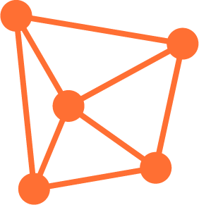
The power of every service everywhere.
Global network
Every
data-center
Every
server
Every
service

Slide 7
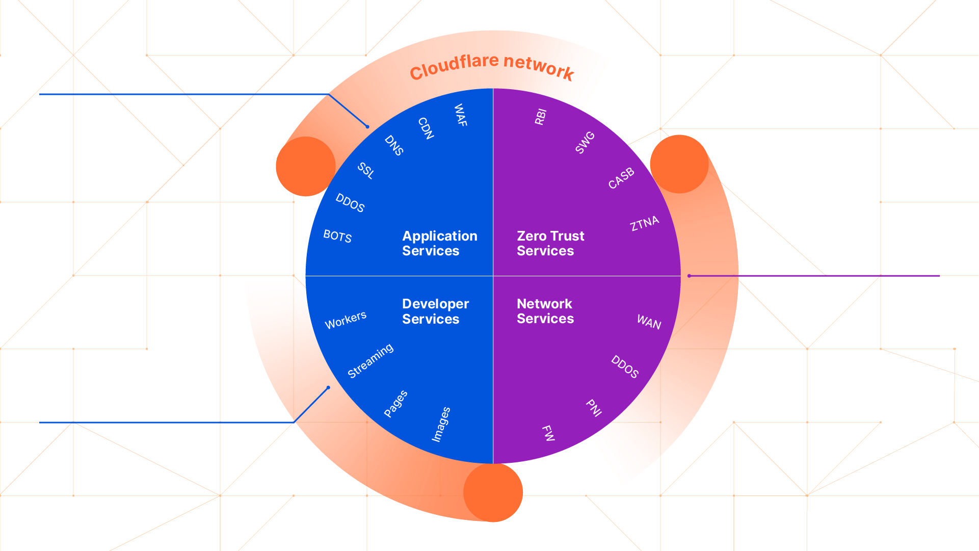
Platform
For your customers
For your employees
For your developers

Slide 8
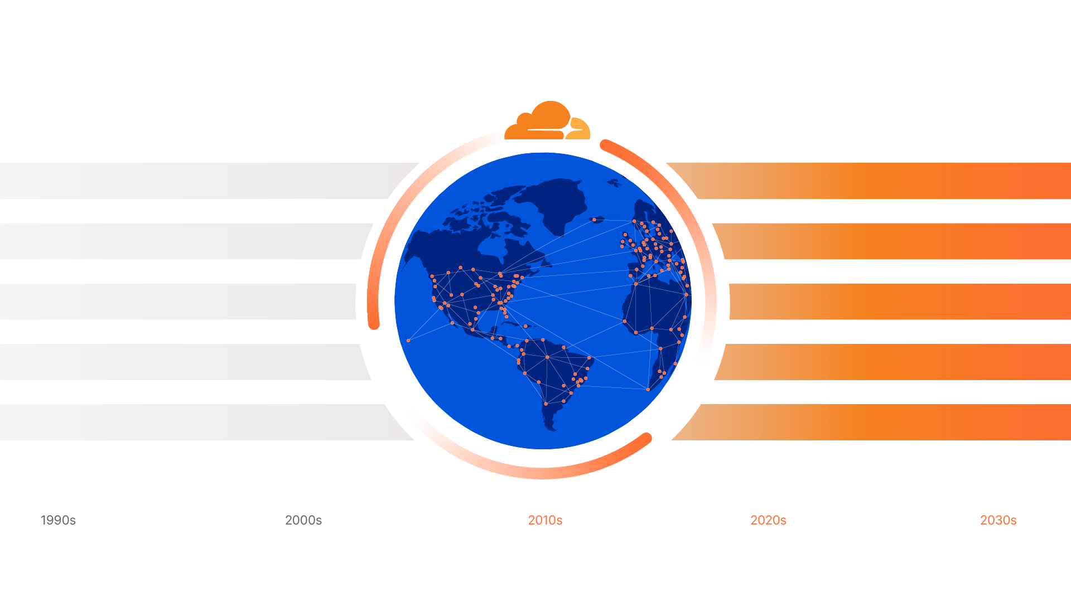
Cloudflare enables the
Transitions needed for
digital transformation
Inconsistent Web
Instant Experiences
Centralized
Distributed Computing
Data Collection
Data Privacy
Perimeter
Zero Trust
Proprietary Circuits
Network as a Service
Notes:
Cloudflare exists to build a better Internet.
Cloudflare’s value is in enabling an Internet that is secure, reliable, private, and automated.
As you embark on the transitions in your infrastructure, we value the opportunity to gain your trust.

Slide 9
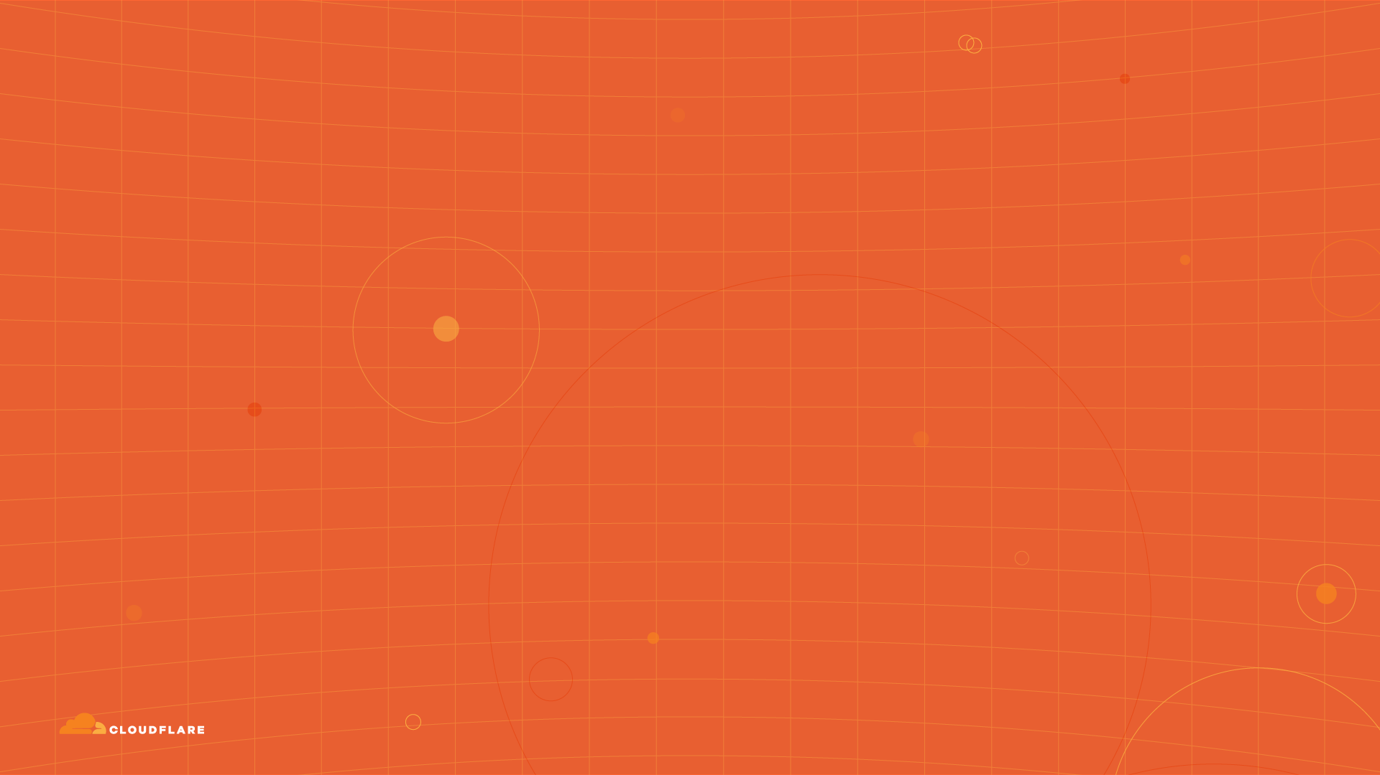
Why is Cloudflare
better?

Slide 10
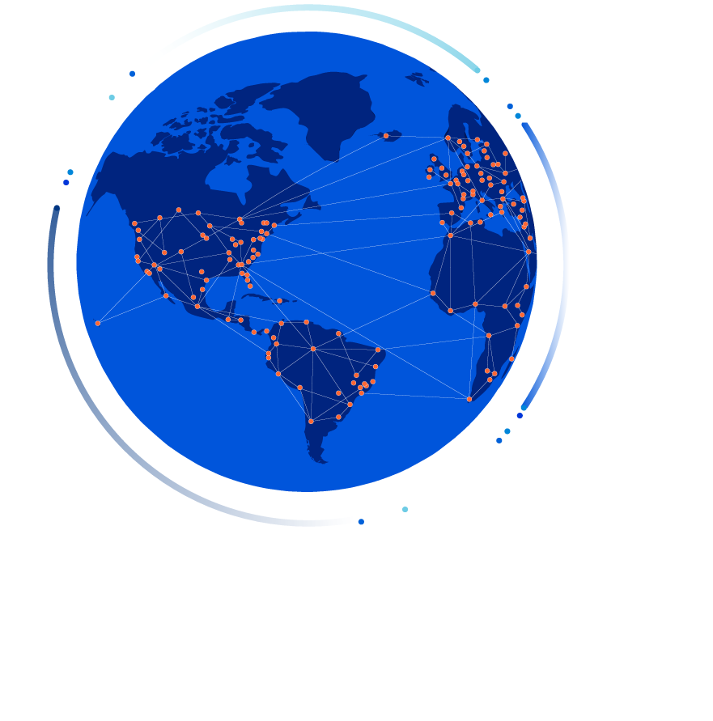
The fastest network.
Period.
Less than 50ms from 95% of the Internet.
Consistent security and performance
for every user.
Global network spanning 250 cities across
100+ countries. Scale stops attacks where
they are launched.
Peered/interconnected with 10,000 networks
globally including major ISPs, cloud providers,
and large enterprises.

Slide 11
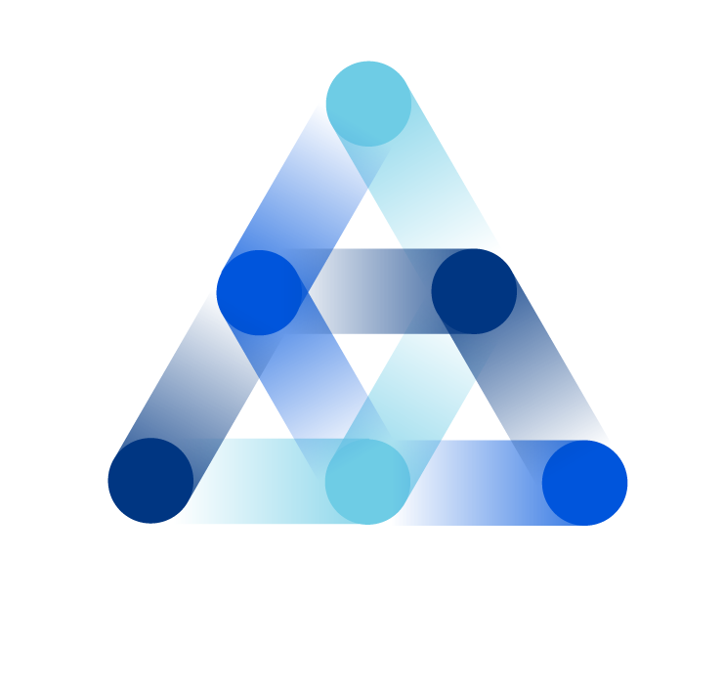
Broad set of
composable services.
Single Control Plane with one dash
and one API.
Every server runs every service
in every data center.
Built natively from the ground up within
a consistent architecture.
Reduces your attack surface while
simultaneously improving performance.
Notes:
Benefits:
Lowest Labor footprint
Highest Ops employee retention
Reduce largest IT spend item
MSSP/ SI/ CSP can have full service catalogue overnight
What your IT org can migrate from:
Cost Flexibility/Adjustment/Reconfiguration - low cost centers
What your IT org can become:
Innovation Flexibility/Evolution - high skilled centers

Slide 12
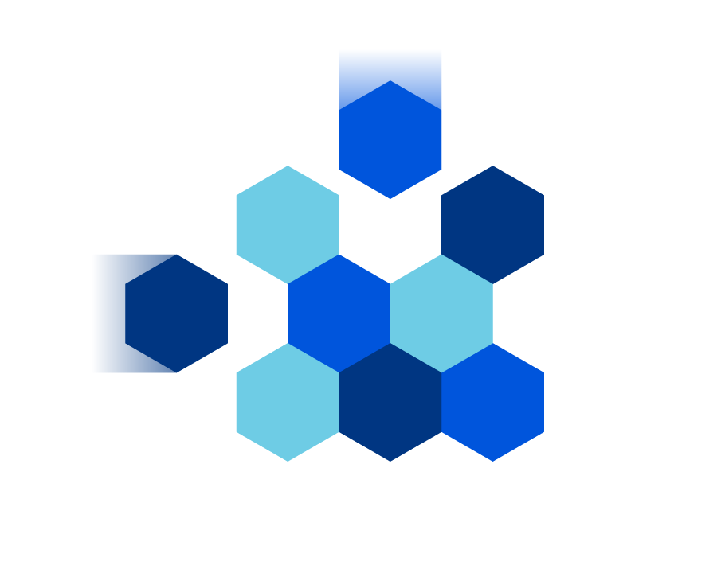
We fit into your world
not the other way around.
Leverage any cloud, SaaS, API, or other
modern application tools.
Use your existing identity, endpoint, SecOps, DevOps, and ITOps tools.
Connect directly from any major carrier,
Internet exchanges, or downtown
office building.
Comply with local privacy and security requirements.

Slide 13
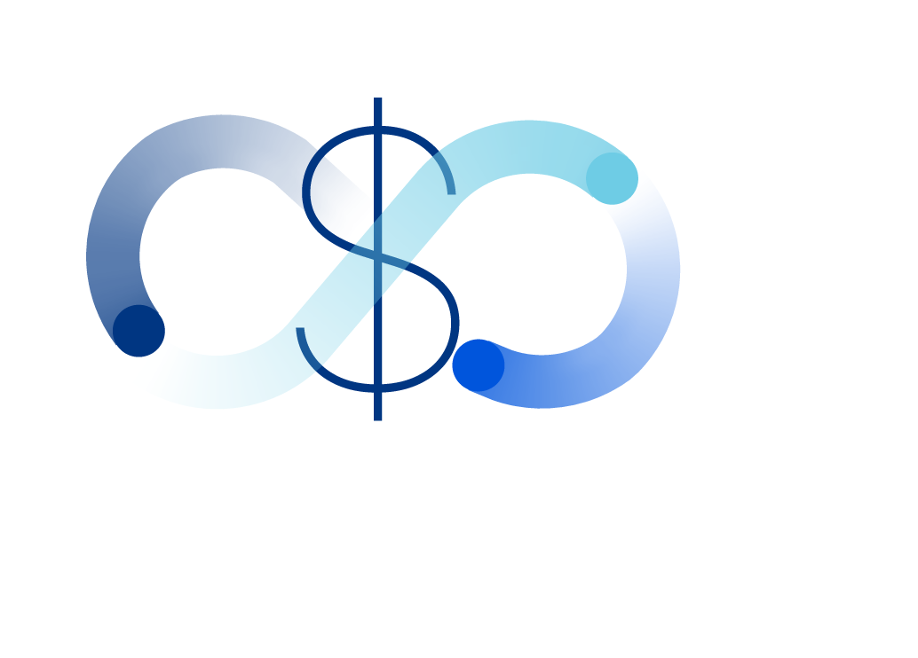
An amazing ROI,
no matter how you count it.
Right sized product packages with
no surprise billing.
Single-click ease of use means you need
fewer skilled individuals. Make changes
instantly, not in hours.
Typical public cloud savings of ~30%
plus egress fees discounted with Azure
GCP, and others.
Commodity hardware running Cloudflare
software means a different cost structure
for delivering affordable high-quality.

Slide 14
Customer results

Slide 15




Typical Results
from Customers
Reduce the average cost of a data breach from
$5.04M → $3.28M
up to
as much as
up to
makes it
95%
60%
80%
39%
Reduce attack surface
Faster rate of new user and device onboarding
Decrease time spent addressing remote access IT tickets
Faster to connect to applications and services
Notes:
Breach cost: IBM, Cost of a Data Breach Report, 2021, https://www.ibm.com/downloads/cas/OJDVQGRY
Attack surface: Gartner, Hype Cycle for Network Security, 2021, https://www.cloudflare.com/static/e377b0bdef177342347d01afca28c09f/Hype_Cycle_for_Network_Security__2021.pdf
Onboarding rate: eTeacher Group Case Study, 2021, https://www.cloudflare.com/case-studies/eteacher-group/
IT time spent: Cloudflare Case Study, 2020, https://www.cloudflare.com/case-studies/how-cloudflare-uses-cloudflare-access-to-secure-our-global-team/
Faster connection: Cloudflare Argo 2.0 Blog, 2021, https://blog.cloudflare.com/argo-v2/
A good way to talk the impact of Cloudflare:
Business Impact - Make
Operational Impact - Save
Financial Impact - Over time

Slide 16



Trusted by the
world’s leading brands
8 of top 20
6 of top 10
5 of top 10
3 of top 5
4 of top 10
5 of top 10
9 of top 10
5 of top 10
3 of top 10
Pharma
Telecom
Auto
Software
Financials
Retail
Notes:
Some questions to ask your customer:
Do you measure units cost against these peers?
Do you measure innovation cycles against these peers?
These leaders didn't come to cloudflare for ONE thing.

Slide 17
How can we help?

